Slide 1
Data Structure and Algorithms
CPS 2232
DR. HEMN BARZAN ABDALLA
FALL 2021

Slide 2
Assessment
Absent 5%
Class Activity 10%
Assignment 20%
Mid-Term Exam 20%
Project 20%
Final Exam 25%

Slide 3
Objects and Classes with SubClass
OO Programming Concepts
Creating Objects and Object Reference Variables
  Differences between primitive data type and object type
  Automatic garbage collection
Constructors
Modifiers (public, private and static)
Instance and Class Variables and Methods
Scope of Variables
Use the this Keyword
Case Studies (Mortgage class and Count class)

Slide 4
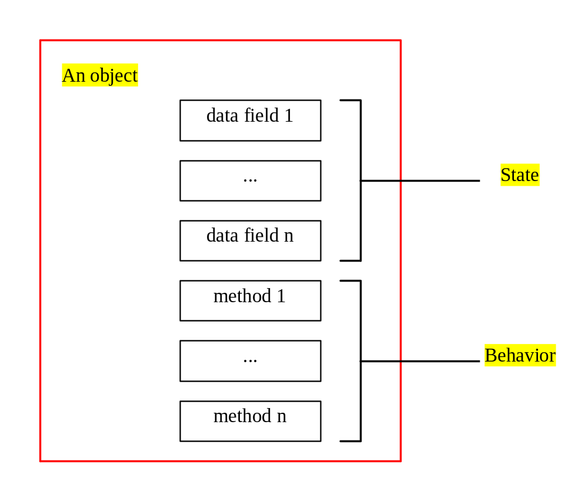
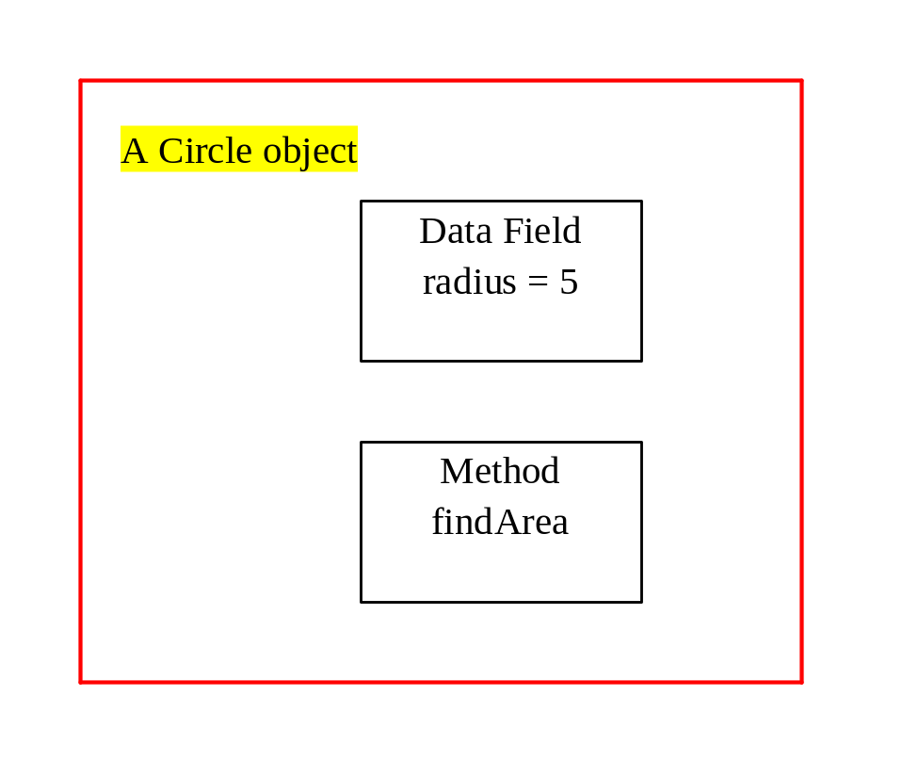
OO Programming Concepts

Slide 5
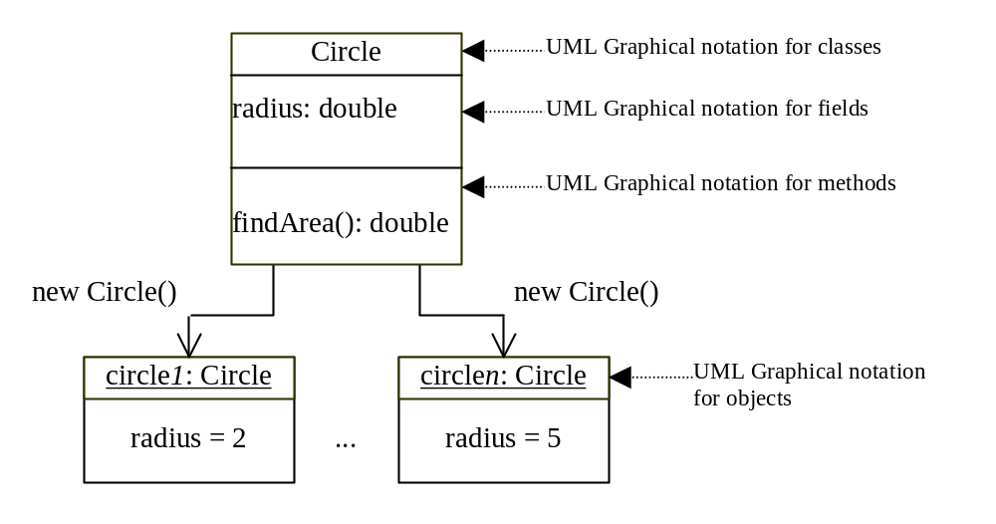
Class and Objects
Notes:
1…….n-1

Slide 6
Class Declaration
class Circle {
double radius = 1.0;
double findArea(){
return radius * radius * 3.14159;
// 1.0x1.0x3.14159=3.14159
}
}

Slide 7
Declaring Object Reference Variables
ClassName objectReference;
Example:
Circle myCircle;

Slide 8
Creating Objects
objectReference = new ClassName();
Example:
myCircle = new Circle();
The object reference is assigned to the object reference variable.

Slide 9
Declaring/Creating Objects in a Single Step
ClassName objectReference = new ClassName();
Example:
Circle myCircle = new Circle();

Slide 10
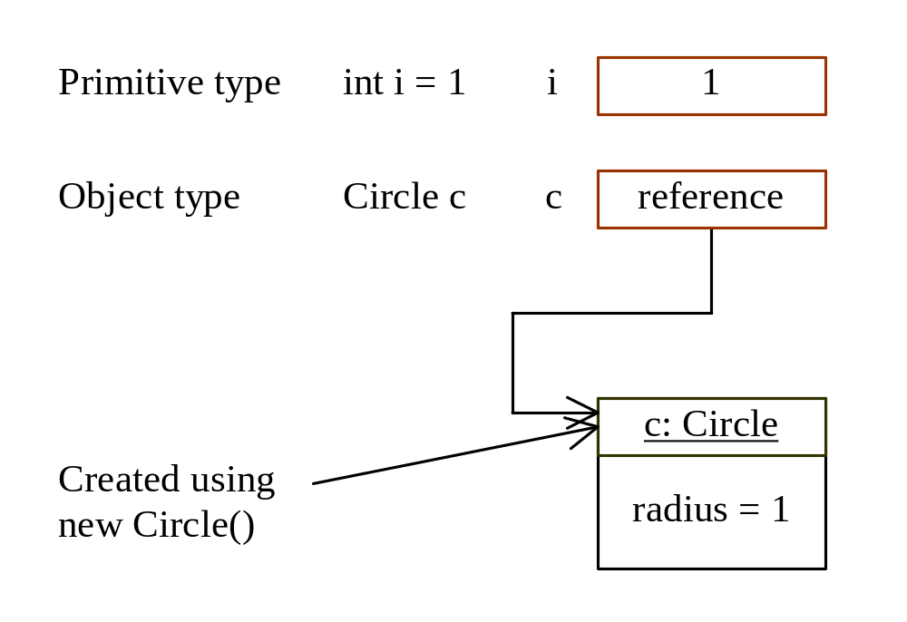
Differences between variables of primitive Data types and object types

Slide 11
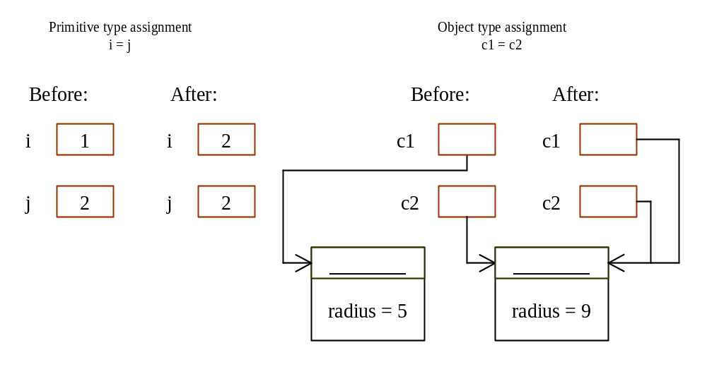
Copying Variables of Primitive Data Types and Object Types
5
9
9
9

Slide 12
Accessing Objects
Referencing the object’s data:
objectReference.data
Ex: myCircle.radius
Invoking the object’s method:
objectReference.method
Ex: myCircle.findArea()

Slide 13
Constructors
Circle(double r) {
radius = r;
}
Circle() {
radius = 1.0;
}
myCircle = new Circle(5.0);
Constructors are a special kind of methods that are invoked to construct objects.

Slide 14
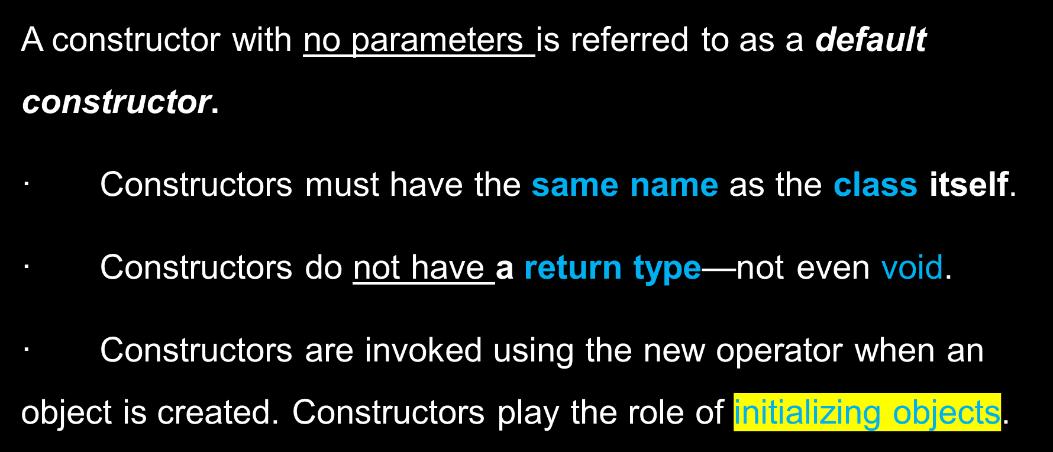
Constructors, cont.

Slide 15
Example 6.3 Using Constructors
Class A{
int i;
float f;
Public A(){
i=5;
f=5.5;
z=i+f;
System.out.println(z)
}
Public A(int k){
i=k;
}

Slide 16
Visibility Modifiers and Accessor Methods
By default, the class, variable, or data can be
accessed by any class in the same package.
public
The class, data, or method is visible to any class in any package.
private
The data or methods can be accessed only by the declaring class.
The get and set methods are used to read and modify private properties.

Slide 17
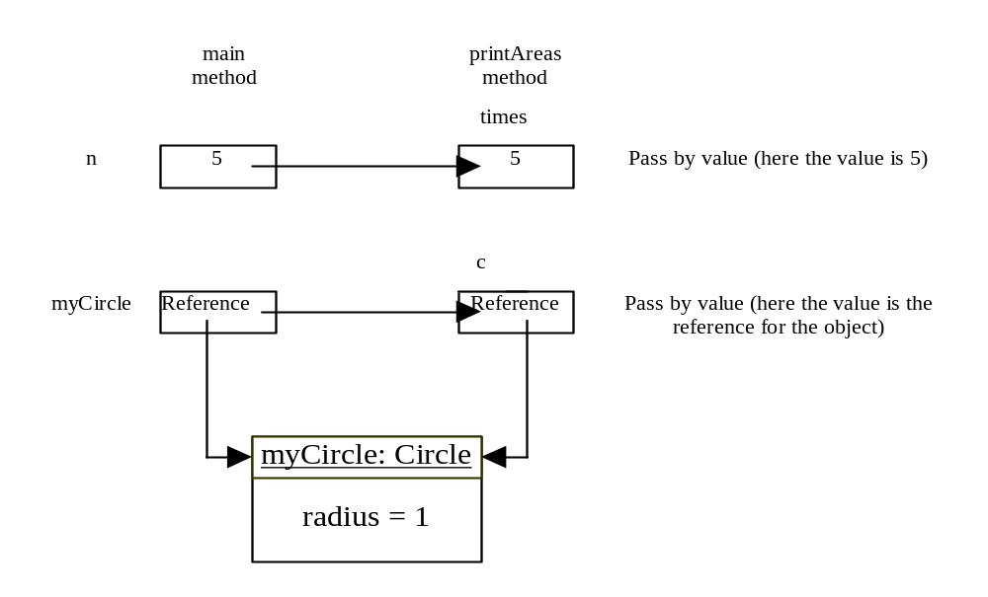
Passing Objects to Methods, cont.

Slide 18
Java API and Core Java classes
java.lang
  Contains core Java classes, such as numeric classes, strings, and objects. This package is implicitly imported to every Java program.
java.awt
  Contains classes for graphics.
java.applet
  Contains classes for supporting applets.

Slide 19
Java API and Core Java classes, cont.
java.io
  Contains classes for input and output streams and files.
java.util
  Contains many utilities, such as date.
java.net
  Contains classes for supporting network communications.

Slide 20
Java API and Core Java classes, cont.
java.awt.image
  Contains classes for managing bitmap images.
java.awt.peer
  Platform-specific GUI implementation.
Others:
java.sql
java.rmi

Slide 21
Abstract Classes and Interfaces

Slide 22
Motivations
You have learned how to write simple programs to create and display GUI components. Can you write the code to respond to user actions, such as clicking a button to perform an action?
In order to write such code, you have to know about interfaces. An interface is for defining common behavior for classes (including unrelated classes). Before discussing interfaces, we introduce a closely related subject: abstract classes.

Slide 23
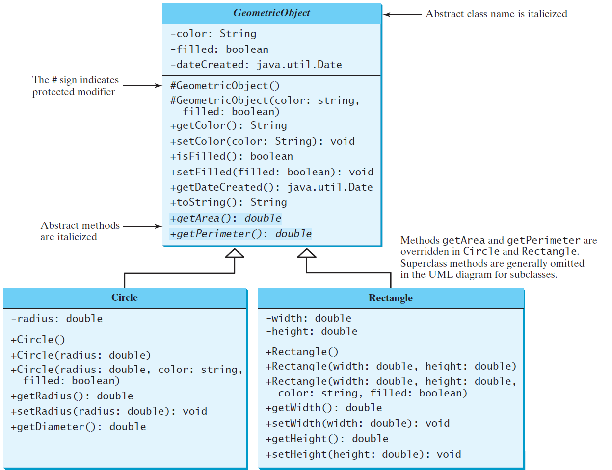
Abstract Classes and Abstract Methods
GeometricObject
Circle
Rectangle
TestGeometricObject
Run

Slide 24
abstract method in abstract class
An abstract method cannot be contained in a nonabstract class. If a subclass of an abstract superclass does not implement all the abstract methods, the subclass must be defined abstract. In other words, in a nonabstract subclass extended from an abstract class, all the abstract methods must be implemented, even if they are not used in the subclass.

Slide 25
object cannot be created from abstract class
An abstract class cannot be instantiated using the new operator, but you can still define its constructors, which are invoked in the constructors of its subclasses. For instance, the constructors of GeometricObject are invoked in the Circle class and the Rectangle class.

Slide 26
abstract class without abstract method
A class that contains abstract methods must be abstract. However, it is possible to define an abstract class that contains no abstract methods. In this case, you cannot create instances of the class using the new operator. This class is used as a base class for defining a new subclass.

Slide 27
superclass of abstract class may be concrete
A subclass can be abstract even if its superclass is concrete. For example, the Object class is concrete, but its subclasses, such as GeometricObject, may be abstract.

Slide 28
concrete method overridden to be abstract
A subclass can override a method from its superclass to define it abstract. This is rare, but useful when the implementation of the method in the superclass becomes invalid in the subclass. In this case, the subclass must be defined abstract.

Slide 29
abstract class as type
You cannot create an instance from an abstract class using the new operator, but an abstract class can be used as a data type. Therefore, the following statement, which creates an array whose elements are of GeometricObject type, is correct.
GeometricObject[] geo = new GeometricObject[10];

Slide 30
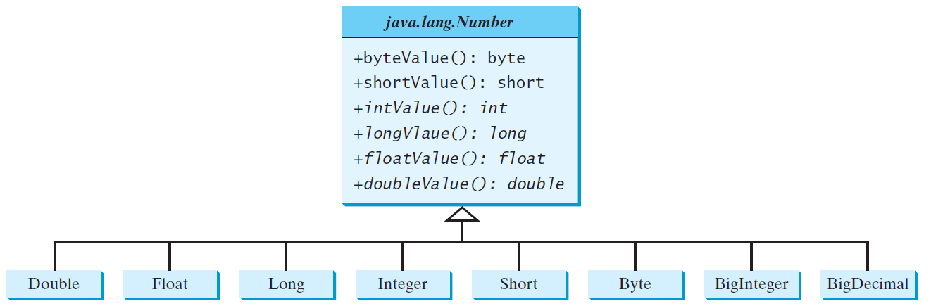
Case Study: the Abstract Number Class
LargestNumbers
Run

Slide 31
Interfaces
What is an interface?
Why is an interface useful?
How do you define an interface?
How do you use an interface?

Slide 32
What is an interface?
Why is an interface useful?
An interface is a classlike construct that contains only constants and abstract methods. In many ways, an interface is similar to an abstract class, but the intent of an interface is to specify common behavior for objects. For example, you can specify that the objects are comparable, edible, cloneable using appropriate interfaces.

Slide 33
Define an Interface
To distinguish an interface from a class, Java uses the following syntax to define an interface:
public interface InterfaceName {
constant declarations;
abstract method signatures;
}
Example:
public interface Edible {
/** Describe how to eat */
public abstract String howToEat();
}

Slide 34
Interface is a Special Class
An interface is treated like a special class in Java. Each interface is compiled into a separate bytecode file, just like a regular class. Like an abstract class, you cannot create an instance from an interface using the new operator, but in most cases you can use an interface more or less the same way you use an abstract class. For example, you can use an interface as a data type for a variable, as the result of casting, and so on.

Slide 35
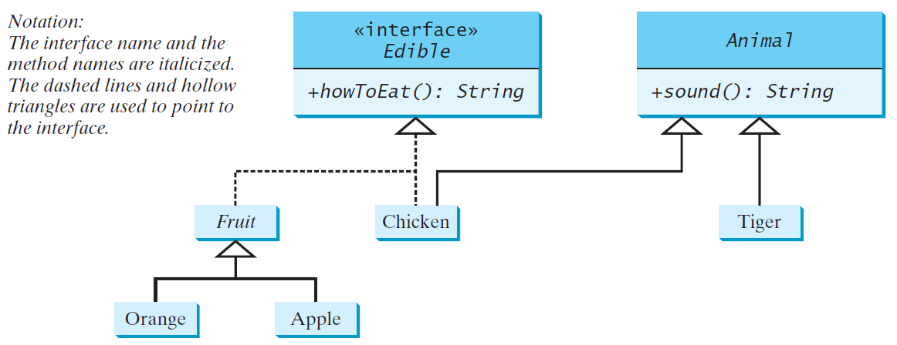
Example
You can now use the Edible interface to specify whether an object is edible. This is accomplished by letting the class for the object implement this interface using the implements keyword. For example, the classes Chicken and Fruit implement the Edible interface (See TestEdible).
Edible
TestEdible
Run

Slide 36
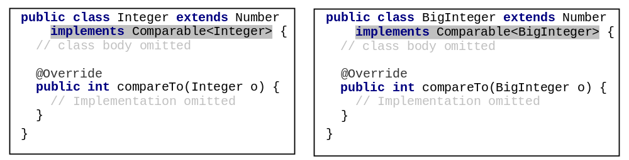
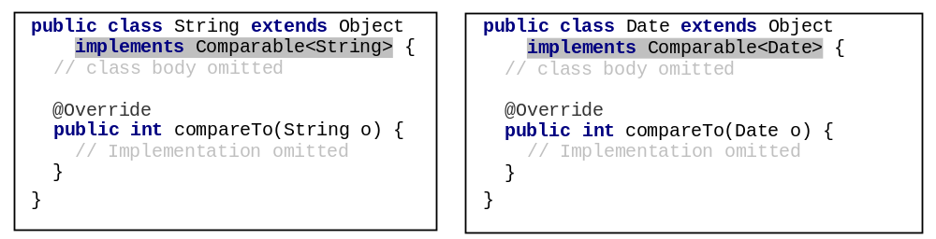
Integer and BigInteger Classes
String and Date Classes

Slide 37
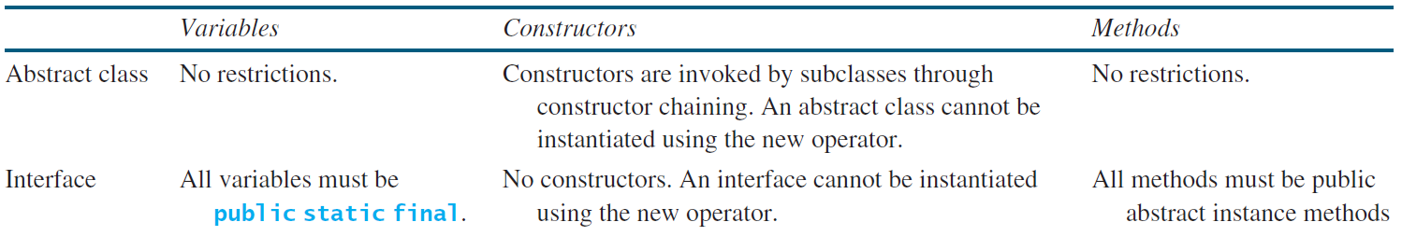
Interfaces vs. Abstract Classes
  In an interface, the data must be constants; an abstract class can have all types of data.
  Each method in an interface has only a signature without implementation; an abstract class can have concrete methods.

Slide 38
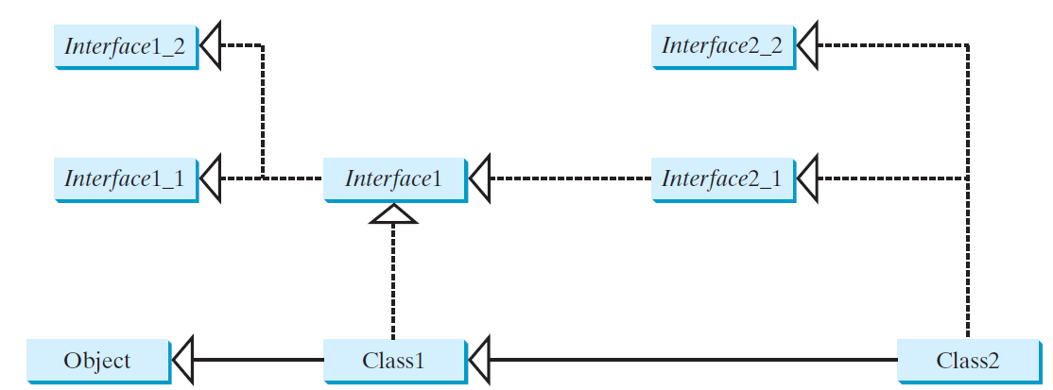
Interfaces vs. Abstract Classes, cont.
  All classes share a single root, the Object class, but there is no single root for interfaces. Like a class, an interface also defines a type. A variable of an interface type can reference any instance of the class that implements the interface. If a class extends an interface, this interface plays the same role as a superclass. You can use an interface as a data type and cast a variable of an interface type to its subclass, and vice versa.
  Suppose that c is an instance of Class2. c is also an instance of Object, Class1, Interface1, Interface1_1, Interface1_2, Interface2_1, and Interface2_2.

Slide 39
Whether to use an interface or a class?
  Abstract classes and interfaces can both be used to model common features. How do you decide whether to use an interface or a class? In general, a strong is-a relationship that clearly describes a parent-child relationship should be modeled using classes. For example, a staff member is a person. A weak is-a relationship, also known as an is-kind-of relationship, indicates that an object possesses a certain property. A weak is-a relationship can be modeled using interfaces. For example, all strings are comparable, so the String class implements the Comparable interface. You can also use interfaces to circumvent single inheritance restriction if multiple inheritance is desired. In the case of multiple inheritance, you have to design one as a superclass, and others as interface.

Slide 40
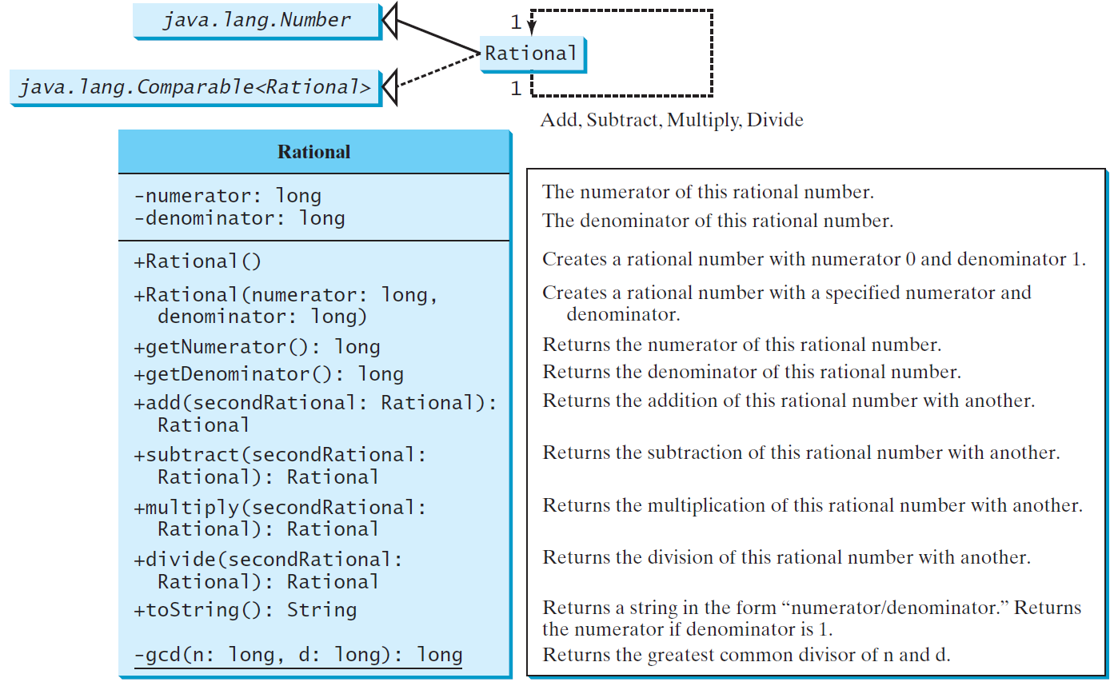
The Rational Class
Rational
TestRationalClass
Run

